Slide 1
Apache Hadoop works on Data Locality principle which states that move computation to data instead of data to computation, this reduces network congestion and therefore, enhances the overall system throughput.
HDFS Throughput - Throughput is the amount of work done in a unit time
In hadoop, the task is divided among different blocks, the processing is done parallel and independent to each other. so because of parallel processing, HDFS has high throughput.
HDFS Advantage:
Support the storage of massive data.
Detect and quickly respond to hardware failures.
Streaming data access.
Simplified consistency model.
High fault tolerance.
Commercial hardware.
HDFS Disadvantage:
Can not achieve low-latency data access.
Not suitable for a large number of small file storage.
File modification is not supported (HDFS 2.x supports appending content to files).
Parallel writing by users is not supported.
https://katcr.to/udemy-apache-spark-3-beyond-basics-and-cracking-job-interviews-t5046440.html
The cluster mode will run driver and executor both in the spark cluster.
The client mode will run the driver in the local machine, and the executors will run in the cluster.

Slide 3
Spark session is a unified entry point of a spark application from Spark 2.0. It provides a way to interact with various spark’s functionality with a lesser number of constructs. Instead of having a spark context, hive context, SQL context, now all of it is encapsulated in a Spark session.
Some History….
Prior Spark 2.0, Spark Context was the entry point of any spark application and used to access all spark features and needed a sparkConf which had all the cluster configs and parameters to create a Spark Context object. We could primarily create just RDDs using Spark Context and we had to create specific spark contexts for any other spark interactions. For SQL SQLContext, hive HiveContext, streaming Streaming Application. In a nutshell, Spark session is a combination of all these different contexts. Internally, Spark session creates a new SparkContext for all the operations and also all the above-mentioned contexts can be accessed using the SparkSession object.
How do I create a Spark session?
A Spark Session can be created using a builder pattern.
import org.apache.spark.sql.SparkSession val spark = SparkSession.builder.appName("SparkSessionExample") .master("local[4]") .config("spark.sql.warehouse.dir", "target/spark-warehouse").enableHiveSupport().getOrCreate
The spark session builder will try to get a spark session if there is one already created or create a new one and assigns the newly created SparkSession as the global default. Note that enableHiveSupport here is similar to creating a HiveContext and all it does is enables access to Hive metastore, Hive serdes, and Hive udfs.
Note that, we don’t have to create a spark session object when using spark-shell. It is already created for us with the variable spark.

Slide 4
Accessing Spark’s configuration:
We can still access the spark’s configurations using spark session the same way as we used using spark conf .
Why do I need Spark session when I already have Spark context?
A part of the answer would be that it unifies all the different contexts in spark and avoids the developer to worry about creating difference contexts. But apart from this big advantage, the developers of spark have tried to solve the problem when there are multiple users using the same spark context.
Let’s say we have multiple users accessing the same notebook environment which had shared spark context and the requirement was to have an isolated environment sharing the same spark context. Prior to 2.0, the solution to this was to create multiple spark contexts ie spark context per isolated environment or users and is an expensive operation(generally 1 per JVM). But with the introduction of the spark session, this issue has been addressed.
Note: we can have multiple spark contexts by setting spark.driver.allowMultipleContexts to true . But having multiple spark contexts in the same jvm is not encouraged and is not considered as a good practice as it makes it more unstable and crashing of 1 spark context can affect the other.

Slide 5
How do I create multiple sessions?
Spark gives a straight forward API to create a new session which shares the same spark context. spark.newSession() creates a new spark session object. If we look closely at the hash of the spark and session2 , they both are different. In contrast, the underneath spark context is the same.
scala> val session2 = spark.newSession()
session2: org.apache.spark.sql.SparkSession = org.apache.spark.sql.SparkSession@691fffb9
scala> spark
res22: org.apache.spark.sql.SparkSession = org.apache.spark.sql.SparkSession@506bc254
scala> spark.sparkContext
res26: org.apache.spark.SparkContext = org.apache.spark.SparkContext@715fceaf
scala> session2.sparkContext
res27: org.apache.spark.SparkContext = org.apache.spark.SparkContext@715fceaf
Also, we can verify that the spark session gives a unified view of all the contexts and isolation of configuration and environment. We can directly query without creating a SQL Context like we used and run the queries similarly.
Let’s say we have a table called people_session1. This table will be only visible in the session spark . Let's say we created a new session session2 .These tables won’t be visible for when we try to access them and also we can create another table with the same name without affecting the table in spark session.

Slide 6
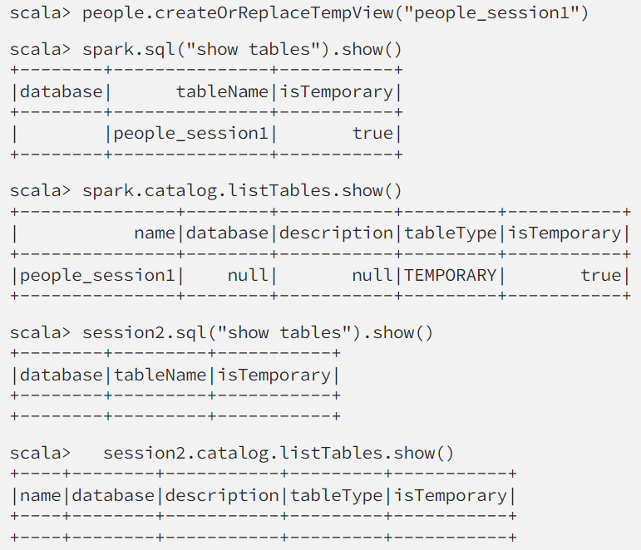
This isolation is for the configurations as well. Both sessions can have their own configs.
scala> spark.conf.get("spark.sql.crossJoin.enabled")
res21: String = true
scala> session2.conf.get("spark.sql.crossJoin.enabled")
res25: String = false
Get the existing configurations:
scala> spark.conf.set("spark.sql.shuffle.partitions", 100)
scala> spark.conf.getAll
res55: Map[String,String] = Map(spark.driver.host -> 19e0778ea843, spark.driver.port -> 38121, spark.repl.class.uri -> spark://19e0778ea843:38121/classes, spark.jars -> "", spark.repl.class.outputDir -> /tmp/spark-cfe820cd-b2f1-4d23-9c9a-3ee42bc78e01/repl-fae1a516-761a-4f31-b957-f5860882478f, spark.sql.crossJoin.enabled -> true, spark.app.name -> Spark shell, spark.ui.showConsoleProgress -> true, spark.executor.id -> driver, spark.submit.deployMode -> client, spark.master -> local[*], spark.home -> /opt/spark, spark.notebook.name -> SparkSessionSimpleZipExample, spark.sql.catalogImplementation -> hive, spark.app.id -> local-1553489583142, spark.sql.shuffle.partitions -> 100)

Slide 7
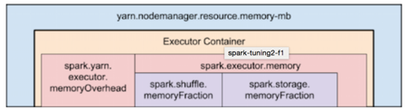
Distribution of Executors, Cores and Memory for a Spark Application running in Yarn
Following list captures some recommendations to keep in mind while configuring them:
Hadoop/Yarn/OS Deamons: When we run spark application using a cluster manager like Yarn, there’ll be several daemons that’ll run in the background like NameNode, Secondary NameNode, DataNode, JobTracker and TaskTracker. So, while specifying num-executors, we need to make sure that we leave aside enough cores (~1 core per node) for these daemons to run smoothly.
Yarn ApplicationMaster (AM): ApplicationMaster is responsible for negotiating resources from the ResourceManager and working with the NodeManagers to execute and monitor the containers and their resource consumption. If we are running spark on yarn, then we need to budget in the resources that AM would need (~1024MB and 1 Executor).
HDFS Throughput: HDFS client has trouble with tons of concurrent threads. It was observed that HDFS achieves full write throughput with ~5 tasks per executor . So it’s good to keep the number of cores per executor below that number.
MemoryOverhead: Following picture depicts spark-yarn-memory-usage.
So, if we request 20GB per executor, AM will actually get 20GB + memoryOverhead = 20 + 7% of 20GB = ~23GB memory for us.
Running executors with too much memory often results in excessive garbage collection delays.
Running tiny executors (with a single core and just enough memory needed to run a single task, for example) throws away the benefits that come from running multiple tasks in a single JVM.
Two things to make note of from this picture:
Full memory requested to yarn per executor = spark-executor-memory + spark.yarn.executor.memoryOverhead. spark.yarn.executor.memoryOverhead = Max(384MB, 7% of spark.executor-memory)

Slide 8
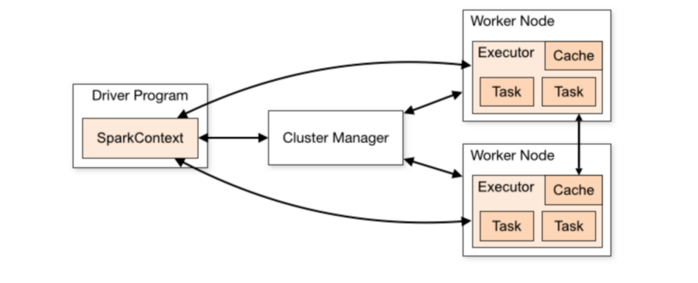
Spark Driver Functions:
Creates SparkContext object
Connection to the cluster is made,
resources are requested,
job is broken down into stages and then further into tasks (schedule and launch tasks on executors).
Defines the transformations and actions applied on the dataset
Driver first requests application master to allocate resources for the containers on the worker nodes. Once allocated by the AM, driver starts communicating with Executors in worker nodes and assign tasks to them.
Through the sparkcontext object it initiated it acquires executors on nodes in the cluster. Next it sends application code to the executors. Finally, tasks are sent to the executors.
Executor:
JVM process responsible for execution of tasks. Many tasks can run in parallel in a single process. These executors stick around in memory for the entire liftime of the spark application, even when no jobs are running. Due to this the app takes up the fixed allotment of resources during the entire duration.

Slide 9
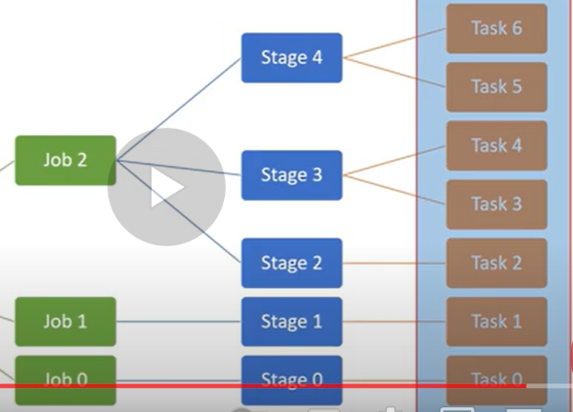
Stages and Tasks
Driver
Spark context object
Executor
ShuffleMapStage - Map
ResultStage – Reduce – initiated by action

Slide 10
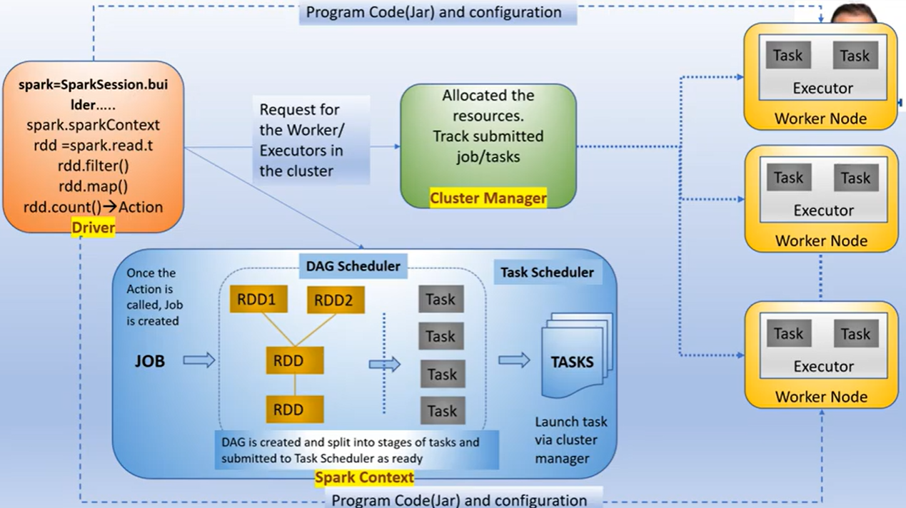

Slide 11
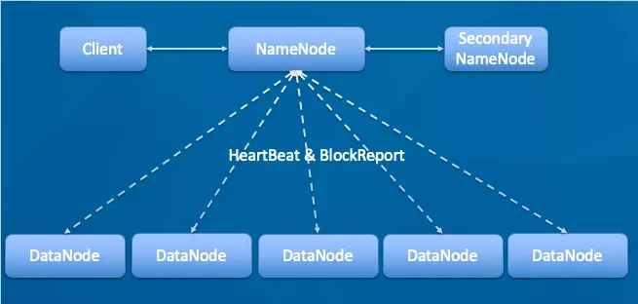
NameNode: It is the master node.
HTTP port is 50700
RPC port is 8020, somebody will reconfigure to 9000 the metadata of the file is stored in the memory of the NameNode
Manage the namespace of HDFS. Management data block (block) mapping information(Metadata of the files is maintained in memory)
Configure the copy policy. Handle the client's read and write requests.
DataNode: The NameNode issues the command, and the
DataNode performs the actual operation. Stores the actual data block. Perform data block read/write operations.
-Will report to the NameNode every 3 seconds – heartbeat -SSH(secured shell protocol) is used for communication to NameNode using port 22

Slide 12
Spark.executor.memory – is divided into
spark.shuffle.memoryFraction – used to contain data related to shuffle or other intermediate outputs and
spark.storage.memoryFraction – used to store the user defined data
Apart from allocated memory, 7% of memory is allocated on top of that to the cluster manager i.e. YARN. You can explicitly set the overhead memory allocated.
--num-executors =
--executor-cores = decides the number of tasks running in that executor in parallel
--executor-memory =
Got HDFS throughput it is recommended to use 4 to 5 executor-cores
A thin executor which means that has lesser number of tasks will be under utilised.
Spark OOM:
2 types
Driver OOM
Executor OOM
Notes:
Spark.executor.memory – is divided into
spark.shuffle.memoryFraction – used to contain data related to shuffle or other intermediate outputs
and
spark.storage.memoryFraction – used to store the user defined data
Apart from allocated memory, 7% of memory is allocated on top of that to the cluster manager i.e. YARN. You can explicitly set the overhead memory allocated.
--num-executors =
--executor-cores = decides the number of tasks running in that executor in parallel
--executor-memory =
Got HDFS throughput it is recommended to use 4 to 5 executor-cores
A thin executor which means that has lesser number of tasks will be under utilised.
Spark OOM:
2 types
Driver OOM
Executor OOM
Driver OOM – Collect operation triggers. This happens when the files from different executors are merged in the driver, and if the file size exceeds the allocated size.
Broadcast join – Assume there are files sitting in executors and 2 smaller files are in two other machine. If 2 files were decided to be broadcasted, they will be sent to driver for merging where suppose the size of the resulting file exceeds the memory, results in OOM.
Avoid this by
increasing the driver memory using spark.driver.memory (default 1 GB)
Reduce the threshold limit for the broadcast table.
Executor OOM – A Node will be assigned certain memory which in turn will have executor container. Within that an executor container will be having YARN memory overhead + Executor Memory(storage memory, execution memory). Whenever Executor OOM happens it is mostly the YARN memory overhead running short of the capacity. Off-heap memory part of executor that accommodates, internal strings are created (in the form of hash table), spark internal objects, if other than Scala is used for programming all the language objects are stored here. Usually YARN memory overhead is 10% of memory assigned to your executor. This has to be proportionately increased in respect to the memory requirement raise of executor (YARN killed the container breaching the memory limits error, then increase the YARN memory overhead part using spark.driver.memoryOverhead (From AWS pages :- By default, memory overhead is set to either 10% of executor memory or 384, whichever is higher. Memory overhead is used for Java NIO direct buffers, thread stacks, shared native libraries, or memory mapped files.)

Slide 13

Driver OOM:
Collect() - After processing the files in various executors, to merge the results, collect() operation is called on the dataframe. As soon as the collect() is called Spark will try to collect all the files in the driver, try to merge it into a single file. Now the resulting file may be a bigger one breeching the memory capacity of the driver resulting in OOM.
Avoid this by
increasing the driver memory using spark.driver.memory (default 1 GB)
Reduce the threshold limit for the broadcast table.
Executor
Part-1
Collect()
Driver
Executor
Part-2
Executor
Part-3

Slide 14
Broadcast join – Assume there are files sitting in executors and 2 smaller files are in two other machine. If 2 files were decided to be broadcasted (in order to avoid shuffling), they will be sent to driver for merging where suppose the size of the resulting file exceeds the memory, results in OOM.
Executor
Part-1
Broadcast()
Driver
Executor
Part-2
Executor
Part-3

Slide 15
Driver OOM:
Collect operation triggers. This happens when the files from different executors are merged in the driver, and if the file size exceeds the allocated size.
Broadcast join – Assume there are files sitting in executors and 2 smaller files are in two other machine. If 2 files were decided to be broadcasted, they will be sent to driver for merging where suppose the size of the resulting file exceeds the memory, results in OOM.
Avoid this by
increasing the driver memory using spark.driver.memory (default 1 GB)
Reduce the threshold limit for the broadcast table.
Executor OOM: A Node will be assigned certain memory which in turn will have executor container. Within that an executor container will be having YARN memory overhead + Executor Memory(storage memory, execution memory). Whenever Executor OOM happens it is mostly the YARN memory overhead running short of the capacity. Off-heap memory part of executor that accommodates, internal strings are created (in the form of hash table), spark internal objects, if other than Scala is used for programming all the language objects are stored here. Usually YARN memory overhead is 10% of memory assigned to your executor. This has to be proportionately increased in respect to the memory requirement raise of executor (YARN killed the container breaching the memory limits error, then increase the YARN memory overhead part using spark.driver.memoryOverhead (From AWS pages :- By default, memory overhead is set to either 10% of executor memory or 384, whichever is higher. Memory overhead is used for Java NIO direct buffers, thread stacks, shared native libraries, or memory mapped files.)

Slide 16
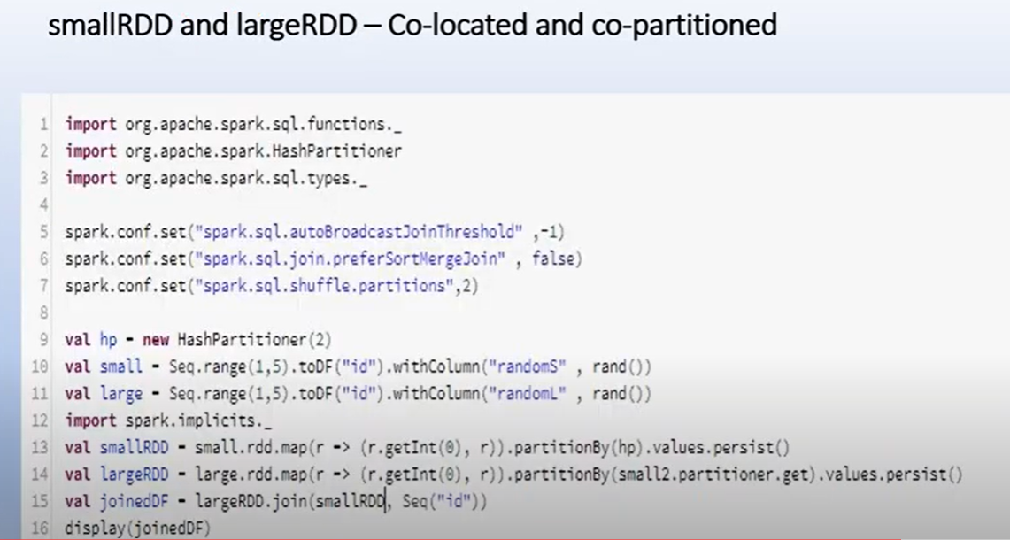
What decides the stages in a spark job?
Stages are created depending on the wide transformations
Spark join without shuffle
Co-locate the RDDs with the joing keyes in the same partition. And this can only happen only if two RDDs can
The same partitioner (hash, hashmap, range partitioner)
were shuffled as part of the same action. Joining keys located in the same partition results in narrow transformation.
SortMergeJoin is the Spark default
Notes:
What decides the stages in a spark job?
Stages are created depending on the wide transformations. Usually s
./bin/spark-submit \ --master <master-url>
\ --deploy-mode <deploy-mode>
\ --conf <key<=<value>
\ --driver-memory <value>g
\ --executor-memory <value>g
\ --executor-cores <number of cores>
\ --jars <comma separated dependencies> --class <main-class>
\ <application-jar>
\ [application-arguments]huffling leads to wide transformations.
--num-executors
--executor-memory
--executor-cores
--driver-memory
Executors are JVMs, they created tasks(tasks are your code that works on the input data. The tasks usually executes in parallel fashion, the number of tasks simultaneously executed is the value assigned to --executor-cores. Core is nothing but CPU allocation for a task. Take note that if the resource available is less than what was assigned to the cores, though the tasks were created matching the value, tasks executed in parallel will be matching the resource availability. The size of resource is defined by –executor-memory. The value “--num-executors” is the executors the job require to finish the task and the number of executors are created are per cluster and not per node.)
How executors are created in the worker nodes ?
A single node can have multiple executors.
--driver-memory – sparksubmit creates a driver. Upon creation, the driver if spark, communicates to the master, if YARN then to application master. Driver will co-ordinate with the jobs executing on the worker node. Collect() or Take() will make the driver to collect complete data from all the worker nodes. This is when the if the data size exceeds the driver memory, will trigger the Driver OOM exception.
SaveAsTextFile() – this will run in parallel and not staging data in driver.

Slide 17
2.3 Driver and Executor Resources (Cores & Memory)
While submitting an application, you can also specify how much memory and cores you wanted to give for driver and executors.
Driver
OPTION | DESCRIPTION
–driver-memory | Memory to be used by the Spark driver.
–driver-cores | CPU cores to be used by the Spark driver
–num-executors | The total number of executors to use. (per cluster and not nodes)
–executor-memory | Amount of memory to use for the executor process.
–executor-cores | Number of CPU cores to use for the executor process. (decides the number of tasks running in that executor in parallel)
–total-executor-cores | The total number of executor cores to use.
Executor
Task
Core

Slide 18
OPTION | DESCRIPTION
Spark.sql.shuffle.partitions | Configures the number of partitions that are used when shuffling data for joins or aggregations (in Datasets and Dataframes)
spark.default.parallelism | default number of partitions in RDDs returned by transformations like join, reduceByKey, and parallelize when not set explicitly by the user (in RDDs)

Slide 19
Driver
creates
communicates
Sparkcontext object
1.Driver
2.Worker
3.Executor
Jobs
Stages
Tasks
Worker Node
NodeManager allocates resources for the executor

Slide 20
./bin/spark-submit \ --master <master-url>
\ --deploy-mode <deploy-mode \ --conf <key<=<value>
\ --driver-memory <value>g \ --executor-memory <value>g \ --executor-cores <number of cores>
\ --jars <comma separated dependencies> --class <main-class> \ <application-jar>
\ [application-arguments]huffling leads to wide transformations.
--num-executors, --executor-memory, --executor-cores, --driver-memory
Executors are JVMs, they create tasks(tasks are your code that works on the input data. The tasks usually executes in parallel fashion, the number of tasks simultaneously executed is the value assigned to --executor-cores. Core is nothing but CPU allocation for a task(core/slot/thread). Take note that if the resource available is less than what was assigned to the cores, though the tasks were created matching the value, tasks executed in parallel will be matching the resource availability. The size of resource is defined by –executor-memory. The value “--num-executors” is the executors the job require to finish the task and the number of executors are created are per cluster and not per node.)
How executors are created in the worker nodes ? A single node can have multiple executors.
--driver-memory – sparksubmit creates a driver. Upon creation, the driver if spark, communicates to the master, if YARN then to application master. Driver will co-ordinate with the jobs executing on the worker node. Collect() or Take() will make the driver to collect complete data from all the worker nodes. This is when the if the data size exceeds the driver memory, will trigger the Driver OOM exception.
SaveAsTextFile() – this will run in parallel and not staging data in driver.

Slide 21
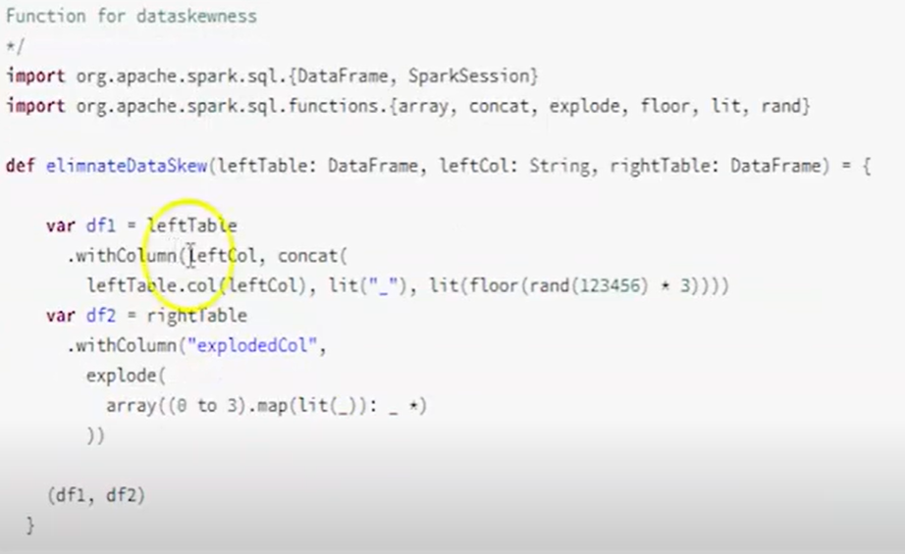
Notes:
Data Skew:
Data distributed storage
Data distributed processing or parallel processing.
1. Data skewness is a common problem in distributed processing.
2. Whenever a key occurs several times in a column and the same column is used in spark join this leads to Data skewness
Ex:
Table A – few million records (large dataset)
Table B – few hundred records (medium dataset)
Join Condition – A.id = B.id
Disadvantages/Issues:
Performace of Spark is impacted
Long running tasks
Under utilization of allocated resources
Resource idleness without performing any task.
Prevents enjoying the advantage of parallel, distributed processing
How to resolve?
Salting Technique
Table A – Concatenate with some character and append some random number between range
Ex: Key +_+Range(1,3)
Table B – Explode the value within some range
Explode(key, Range(1,3))-> x_1,x_2,x_3
Adaptive Query Execution in Spark 3.0
Workarounds to avoid data skewness in Spark 2.0
Repartition – increase the number of partition with equal size. But presence of single dominant partition won’t solve the skewness
Salting Technique -

Slide 22
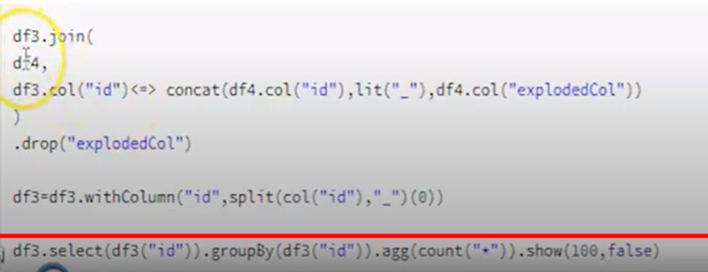

Slide 23
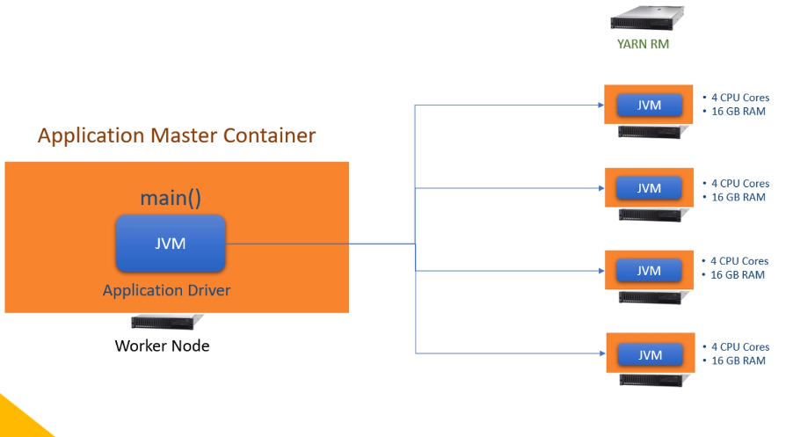
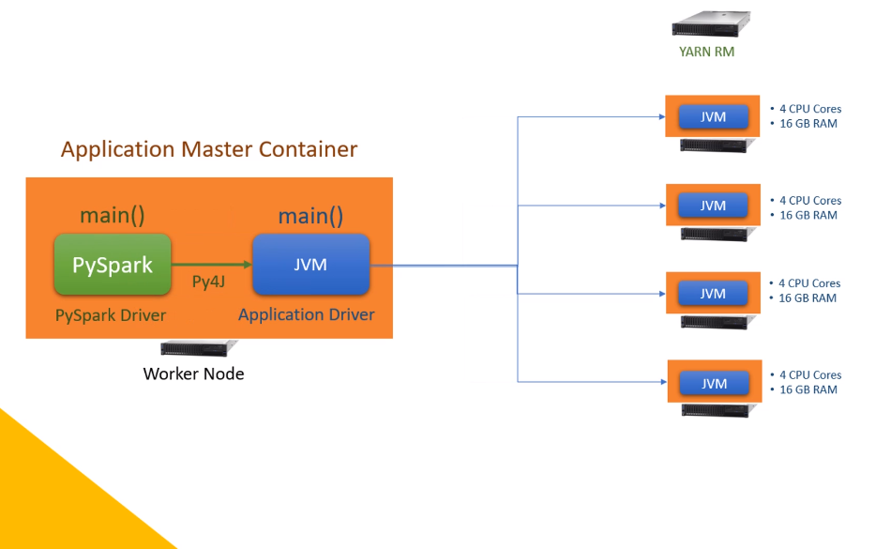
Spark Dataframe using Python will have one PySpark drive, one JVM driver and one or more JVM executors.
Spark Dataframe using Scala or Java will have one JVM driver and one or more JVM executors.

Slide 24
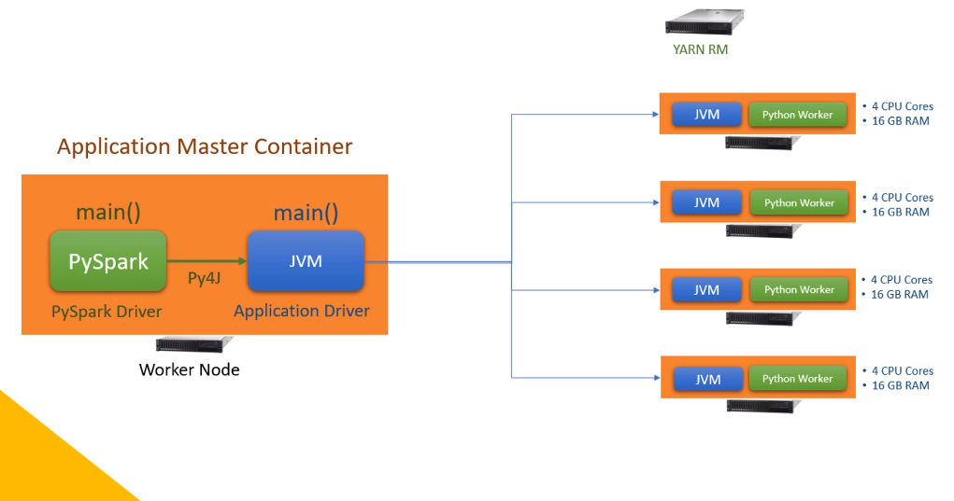
Even if you are creating UDFs in Python, your runtime architecture will look like this. So what is the difference?
You have a Python worker at each executor. What is a Python Worker, and Why do we need them?
Python worker is a Python runtime environment. And you need them only if you are using some python specific code or libraries.
PySpark is a wrapper on Java code. So as long as you are using only PySpark, you do not need a Python runtime environment.
All the PySpark code is translated into Java code, and it runs in the JVM. But if you are using some Python libraries which doesn't have a Java wrapper, you will need a Python runtime environment to run them.
So the executors will create a Python runtime environment so they can execute your Python code.
I will talk more about this in a later video.
But for now, let's remember that you may have Python workers inside the executor container for running custom python code outside the PySpark API.

Slide 25
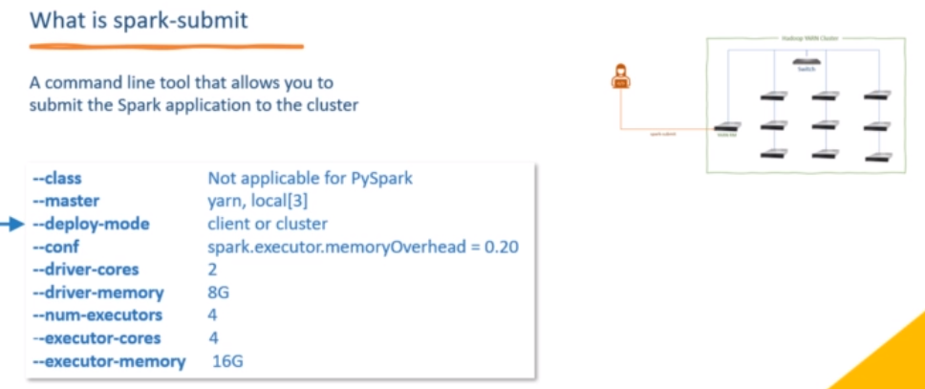
Spark-submit -- class <main-class> --master <master-url> --deploy-mode <deploy-mode> <application-jar> [application-args]
Spark-submit is a command line tool to submit spark application to the cluster
<application-jar> → application jar or pyspark script

Slide 26
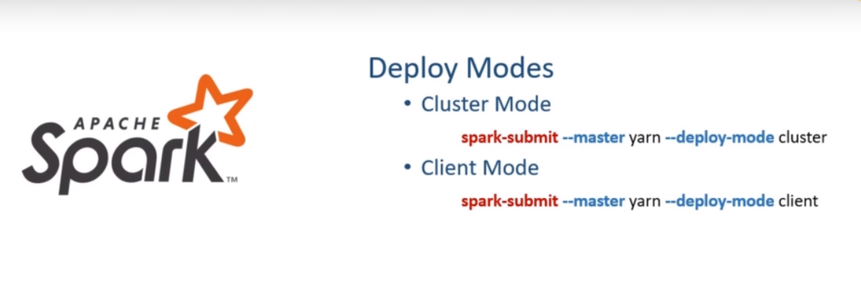
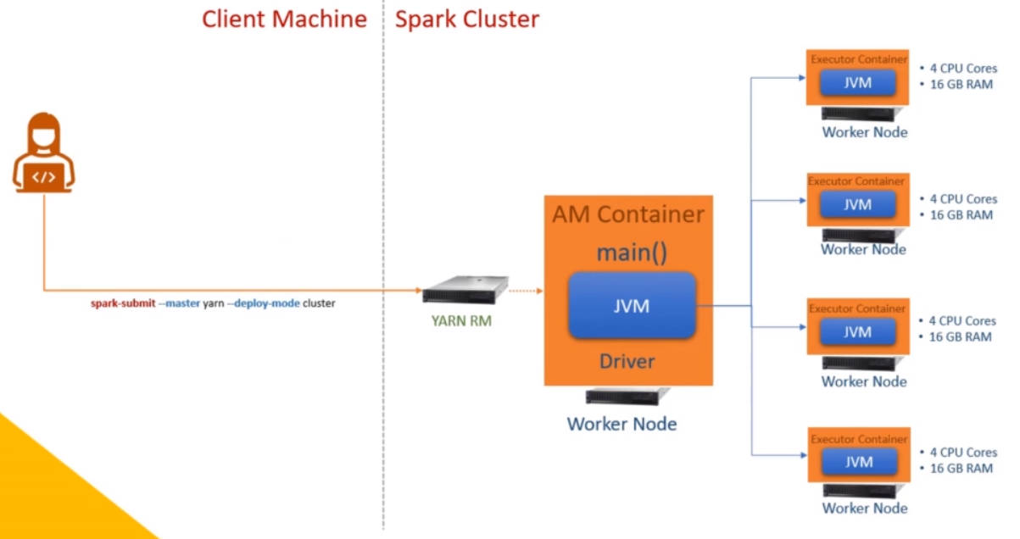
Deploy Mode

Slide 27
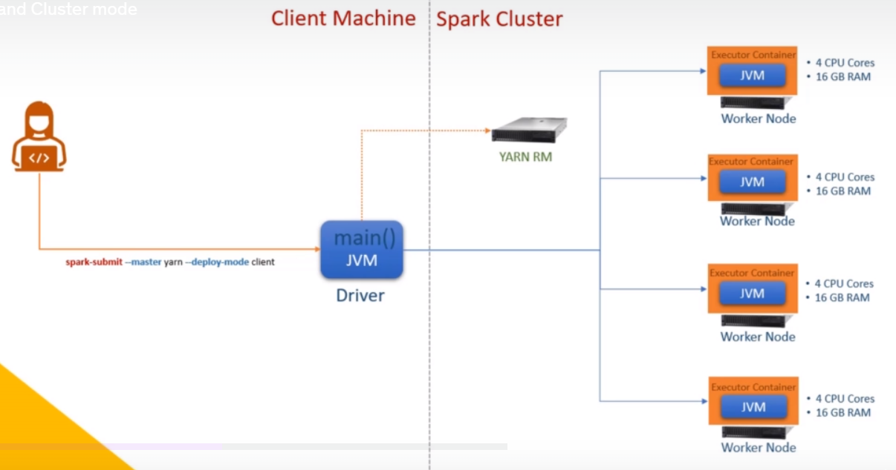

Slide 28
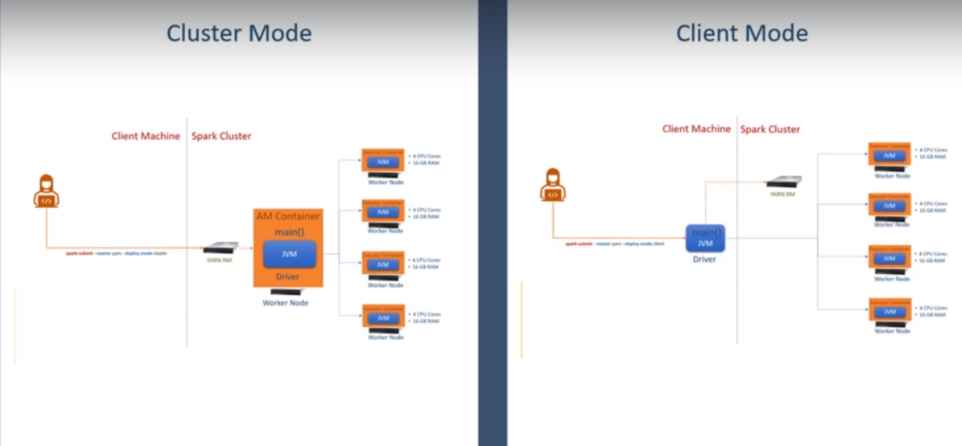

Slide 29
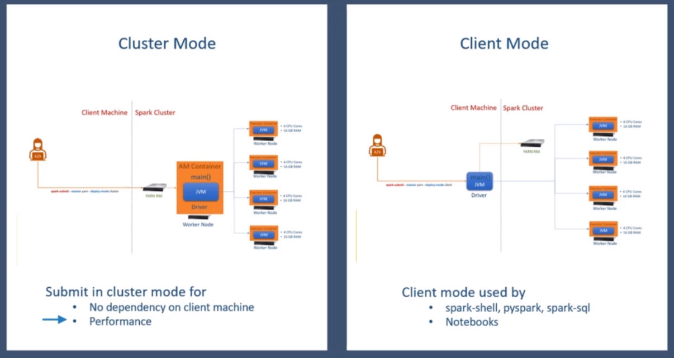

Slide 30
Understanding Spark jobs and stages require you to know about the Spark Dataframe API classification.
Most of the Spark APIs can be classified into two categories.
Transformations and Actions. We also have some functions and objects that are neither transformations nor actions.
However, the majority is grouped in these two categories.
Transformations are used to process and convert data, and they are further classified into two categories.
Narrow Dependency transformations - The narrow dependency transformations can run in parallel on each data partition without grouping data from multiple partitions.
For example, select(), filter(), withColumn(), drop() etc.
All these transformations can be independently performed on each data partition in parallel.
And you do not need to group data for performing these transformations.
Wide Dependency transformations - The Wide dependency transformations require some kind of grouping before they can be applied.
For example, groupBy(), join(), cube(), rollup(), and agg().
All these wide dependency transformations require grouping of data on some key
and then apply the transformation.

Slide 31
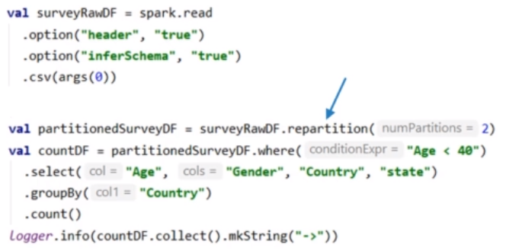
As the name suggests, an Action triggers some work, such as writing a Dataframe to disk, computing the transformations, and collecting the results. Some commonly used actions as read(), write(), collect(), and take() etc.
All spark actions trigger one or more Spark jobs. And that's a supercritical concept.
So now that we learned about the transformations and actions let's take an example code and see how spark runs our code. Here is a super simple spark application code snippet.
The initial surveyRawDF comes from reading a CSV file and inferring the schema. Then I am repartitioning the surveyRawDF and creating a new Dataframe. This new data frame is named partitionedSurveyDF.
I repartitioned it to make sure that I have two internal data partitions. And you should also know that the repartition() is a wide dependency transformation.
In the following line, I am taking a dataframe of two partitions and applying some transformations.
The first transformation is where() method, and that one is a narrow transformation.
Then I have a select() method, and this guy is also a narrow transformation. The third one is a groupBy(), and it is a wide dependency transformation.

Slide 32
This code snippet has got two spark code blocks. How do I know I have two blocks? That's simple. Start from the first line and look for action.
Wherever you find action, your first block ends there, and the following line starts a new block. In this example, my first line itself is an action.
The read() method is an action. So the first block starts at the first line, and it also ends at the first line. The following line starts a new code block.
Then I will keep looking for the action, but I find it only at the last line. So my second block starts from the second line and ends at the last line.
The point is straight. This example has got two code blocks. Why? Because we have two actions in this example.
A typical spark application looks like a set of similar code blocks. This example has got only two blocks, but a large application may have many code blocks. And spark will run each code block as one spark job.
What does it mean? Simple! Each action creates a spark job. And that's why we keep looking for actions to separate spark code blocks. I got two spark actions visible here. So I can assume two Spark jobs here. So I hope you understand the notion of Spark Jobs. It is as simple as each spark action runs as a spark job that contains all the transformations of its code block.
So in this example, let's leave the first block and concentrate on the second code block.

Slide 33
So here is my code block that terminates with a spark action. Your application driver will take this block, compile it and create a Spark job. But this job must be performed by the executors. Why? Because the driver doesn't perform any data processing job. The driver must break this job into smaller tasks and assign them to the executors. So how that happens? Let's see how our job looks like.
Here it is.
The job must start with surveyDF and repartition it to create partitionedSurveyDF. Then it must apply the four transformations to create the countDF. That's all we want to do as part of this job. Right? I ignored the collect action for now, and we will come back to it later.
So this is what we call the logical query plan of your spark job.
I will talk about query planning in a separate video, but you can get a sense here. Spark driver will crate a logical query plan for each spark job. Remember that.
And this example shows how the logical plan looks like. Once we have the logical plan, the driver will start breaking this plan into stages. Let's see how that happens.

Slide 34
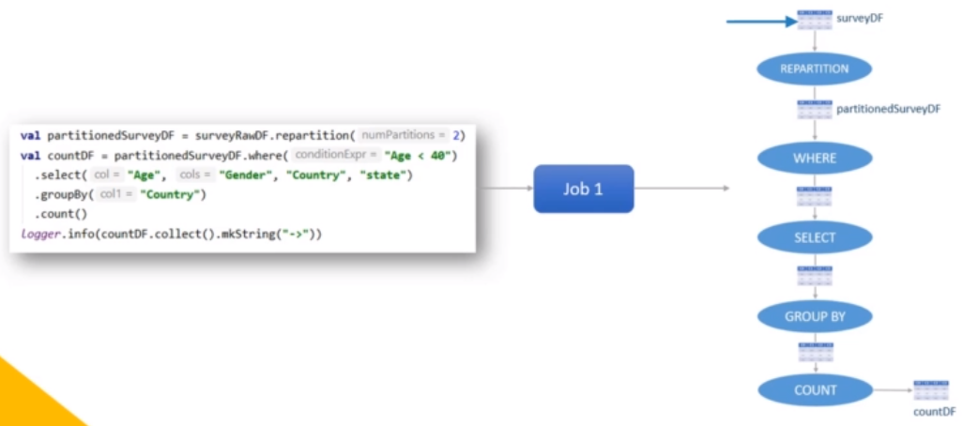

Slide 35
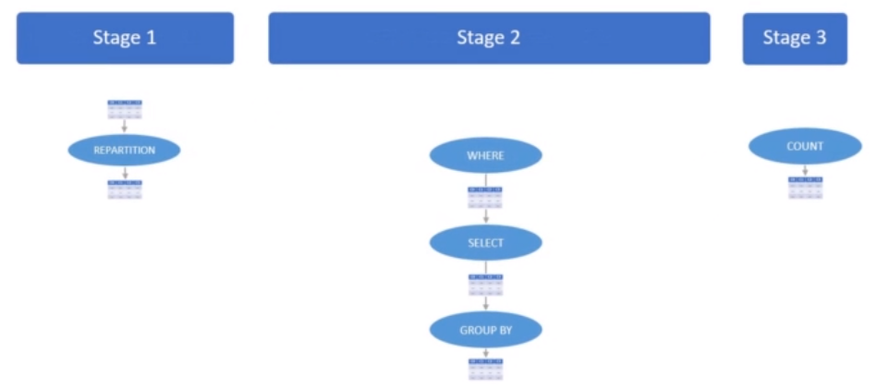
The driver will look at this plan to find out the wide dependency transformations. I have two wide dependencies in this plan.
The first one is the repartition() method, and the second one is the groupBy() method. So the driver will break this plan after each wide dependency.
The first one becomes the first stage. The second one goes to the second stage. Finally, the last one is the third stage.
So here we are. My logical plan is now broken down into three stages. Each stage can have one or more narrow transformations, and the last operation of the stage is a wide dependency transformation.
Spark cannot run these stages in parallel. We should finish the first stage, and then only we can start the next stage. Why?
Because the output of the first stage is an input for the next stage. Isn't it?
So whatever we see here is one spark job, and it is broken down into three stages. All the stages can run one after the other because the output of one stage is input for the next stage.

Slide 36
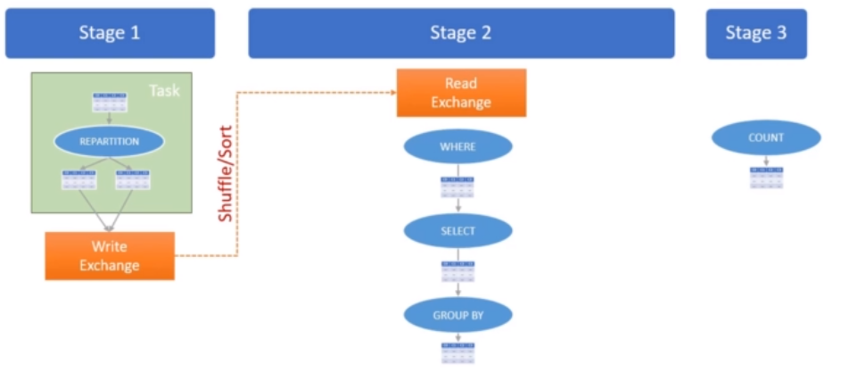
But how the output of one stage goes to the next stage? Let's try to understand that tracing it from the first stage.
What am I doing in the first stage? I am reading surveyDF and repartitioning it to create partitionedSurveyDF.
How many partitions do I have in the surveyDF? Let's assume I have a single partition. How many partitions do I have in the partitionedSurveyDF? Two partitions. Why? Because I wrote my code to repartition it and create two partitions. So it should look like this.
So this entire thing of stage one becomes a task. And the final output of the stage must be stored in an exchange buffer. Let's call it to write exchange. Now the output of one stage becomes the input of the next stage. So the next stage starts with the exchange buffer. Let's call it the read exchange.
Spark is a distributed system. So the Write exchange and the read exchange may be on two different worker nodes. It may be on the same worker, but it can be on two different works.
So we must consider a copy of data partitions from the Write exchange to the read exchange. And this copy operation is popularly known as the Shuffle/Sort operation. The shuffle/sort is not a plain copy of data.
But do remember some points here. The stage ends with a wide dependency transformation, and hence it requires a
shuffle/sort of the data. The Shuffle/Sort is an expensive operation in the Spark cluster. It requires a write exchange buffer and a read exchange buffer. The data from the write exchange buffer is sent to the read exchange buffer over the network.

Slide 37
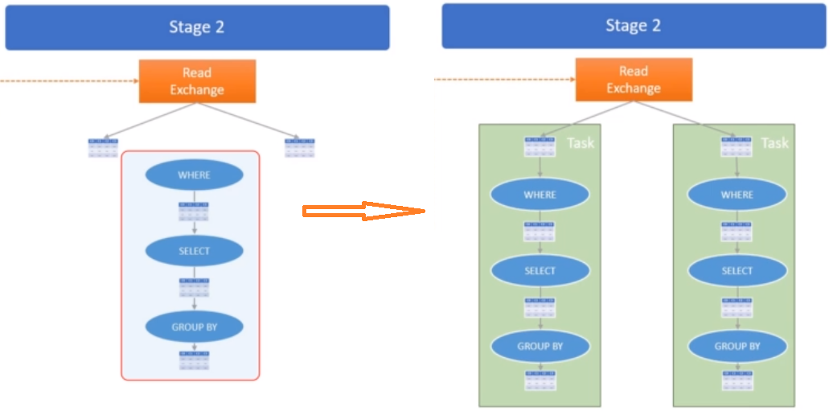
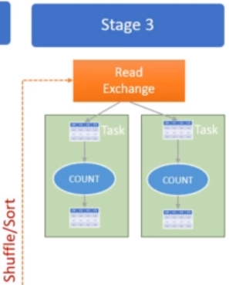
Now let's come to the second stage. The read exchange has got two partitions. Why? Because I created two partitions in the Write exchange of stage one. And I also configured spark shuffle partitions to ensure I preserve those two partitions in the read exchange. So I will have two input partitions here. And now I can run these transformations in parallel on those two partitions. So this is how it looks.
Spark can execute the same plan in parallel on two partitions because I have two partitions.
And this is what we call a task.
So I can have two parallel tasks in stage two.
Stage two also ends with a wide dependency transformation.
So we again need a shuffle/sort operation here. The connection between stage two and stage three looks like this.
Now let's assume I am still keeping two partitions, so my stage three can also run parallel like this. Make sense?
And this is how the final execution plan looks like.

Slide 38
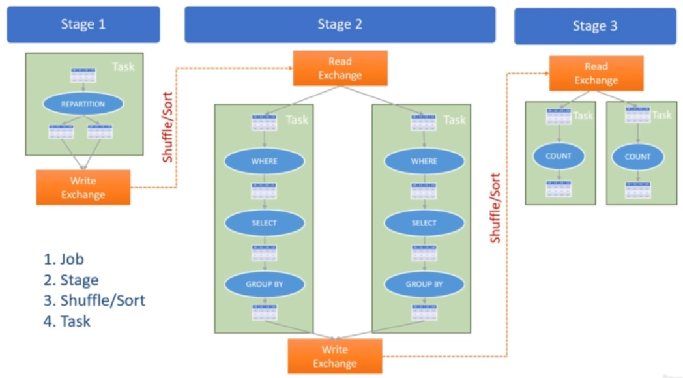

Slide 39
So the Spark driver starts with a logical query plan of a job and converts it to a runtime execution plan. And this is how the runtime execution plan looks for my example spark job.
And it helps you understand the following concepts. Let's quickly revise all these terms. Spark creates one job for each action. This job may contain a series of multiple transformations. The Spark engine will optimize those transformations and create a logical plan for the job.
Then spark will break the logical plan at the end of every wide dependency and create two or more stages. If you do not have any wide dependency, your plan will be a single-stage plan. But if you have N wide-dependencies, your plan should have N+1 stages. Data from one stage to another stage is shared using the shuffle/sort operation.
Now each stage may be executed as one or more parallel tasks. The number of tasks in the stage is equal to the number of input partitions. In our example, the first stage starts with one single partition. So it can have a maximum of one parallel task.
We made sure two partitions in the second stage. So we can have two parallel tasks in stage two.
If I create 100 partitions for stage two, I can have 100 parallel tasks for stage two. The task is the most critical concept for a Spark job. We learned all this so we can reach the task level and understand what a task is. A task is the smallest unit of work in a Spark job. The Spark driver assigns these tasks to the executors and asks them to do the work. The executor needs the following things to perform the task. 1.The task Code and 2. Data Partition
So the driver is responsible for assigning a task to the executor. The executor will ask for the code or API to be executed for the task. It will also ask for the data frame partition on which to execute the given code. The application driver facilitates both these things to the executor, and the executor performs the task.

Slide 40
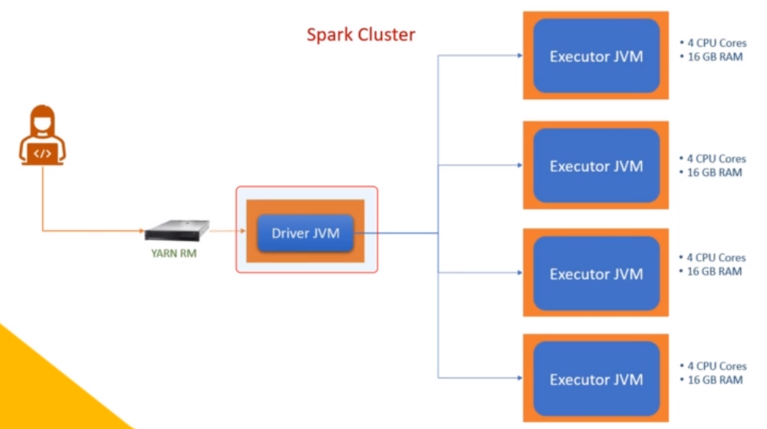
Now let's see how this plan fits into the cluster.
So here is my spark cluster. I have a driver and four executors. Each executor will have one JVM process. But I assigned 4 CPU cores to each executor. So, my Executor-JVM can create four parallel threads.
And that's the slot capacity of my executor.

Slide 41
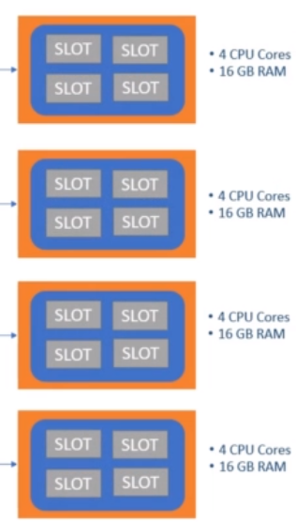
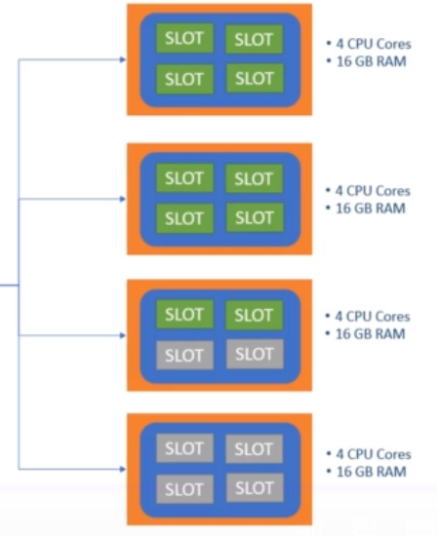
It looks like this.
So each executor can have four parallel threads, and we call them executor slots. The drive knows how many slots do we have at each executor.
The drive knows how many slots do we have at each executor. And he is going to assign tasks to fit in the executor slots. So for this configuration, let's assume the driver has a job stage to finish. And you have ten input partitions for the stage. So you can have ten parallel tasks for the same.
Now the driver will assign those ten tasks in these slots. It might look like this.
And that's the slot capacity of my executor.
It looks like this. So each executor can have four parallel threads, and we call them executor slots. All the green slots are filled. This assignment may not be as uniform as I showed here. But let's assume it is as shown here.
But we have some extra capacity that we are wasting because we do not have enough tasks for this stage. Now let's assume this stage is complete.

Slide 42
All slots are now free. Now the driver should start the next stage. And we have 32 tasks for the next stage. But we have 16 slots only. That's not a problem. The driver will schedule 16 tasks in the available slots. The remaining 16 will wait for slots to become available again. That's how these tasks are assigned and run by the executor.
However, we didn't talk about our actions.
This example had a collect() action in the end. The collect() action requires each task to send data back to the driver. So the tasks of the last stage will send the result back to the driver over the network. The driver will collect data from all the tasks and present it to you.
In my example, I wanted to flush the result into the log so the driver will do the same. If you had an action to write the result in a data file, in that case, all the tasks will write a data file partition and send the partition details to the driver.
The driver considers the job done when all the tasks are successful. If any task fails, the driver might want to retry it. So it can restart the task at a different executor. If all retries also fail, then the driver returns an exception and marks the job failed.

Slide 43
Apache Spark gives you two prominent interfaces to work with data.
1.Spark SQL 2.Dataframe API
Spark SQL is compliant with ANSI SQL:2003 standard. So you can think of it as standard SQL.
Dataframes are function APIs, and they allow you to implement functional programming techniques to process your data. Other than these two, you also have Dataset API available only for Scala and Java.
The Dataframe API internally uses Dataset APIs, but these Dataset APIs are not available in PySpark. If you are using Scala or Java, you can directly use Dataset APIs.
But Spark recommends using Dataframe APIs and avoid using Dataset. You can do almost everything using Dataframes and might not even see a requirement that forces you to use datasets.
The spark certification exam is available in Scala and Python both. But they avoid asking about the features that are different in Scala and Python.
For example, the Dataset is not available in PySpark, so they do not ask anything about it in the certification exam. So you can write spark code using Dataframe APIs, or you can write SQL expressions.
Spark looks at your code in terms of jobs. So if you have a Dataframe API code, Spark will take action and all its preceding transformations to consider it a single Job. Similarly, if you write a SQL expression, Spark considers one SQL expression as one Job.

Slide 44
The point is straight. Spark code is nothing but a sequence of Spark Jobs. And each Spark Job represents a logical query plan.
This first logical plan is a user-created logical query plan. Now this plan goes to Spark SQL engine. You may have Dataframe APIs, or you may have SQL. Both will go to the Spark SQL engine. For Spark, they are nothing but a Spark Job represented as a logical plan.
1
2
3
4
Analysis
Logical Optimization
Physical Planning
Code Generation
Cost Model
Unresolved logical plan
Logical plan
Optimized logical plan
Physical plans
Selected physical plan
RDDs
Catalog
Notes:
Analysis - Syntax, function/column/table mapping are verified and fully resolved logical plan is created.
Logical optimization – standard rule based optimizations to the logical plan like constant folding, predicate pushdown, partition pruning, null propagation, Boolean expression simplification.
Physical planning – takes a logical plan and generates one or more physical plan and is based on cost-based optimization. Finally, least cost based physical plan is selected. (type of joins like broadcast join, sort-merge join are decided)
Code Generation – Best plan is taken for code generation and engine will generate java byte code for the RDD operations in the physical plan. Thus spark is also called a compiler.

Slide 45
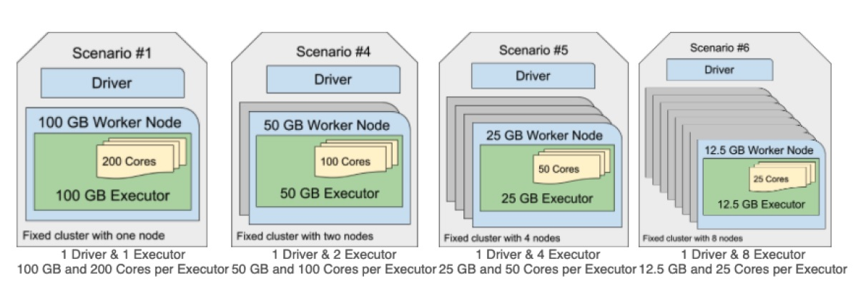
Spark SQL Engine and Query Planning
Question 7:Which of the following cluster configurations will ensure the completion of a Spark application in light of a worker node failure?
Note: each configuration has roughly the same compute power using 100GB of RAM and 200 cores.
They should all ensure completion because worker nodes are fault-tolerant.

Slide 46
Spark Memory Allocation
Spark Driver Memory: Driver memory will be allocated by application master (AM) container and start the driver JVM in the container. Is obtained using the below configurations. 1.Spark.driver.memory
2.Spark.driver.memoryoverhead (usually 10% of driver memory or 384 MB whichever is allocated).
So the total memory of the container will be 1 GB +10% or 384 MB. The overhead memory is used by the container process or any other non-JVM process within the container. Spark Driver uses all the JVM heap but not from the overhead memory.
Spark Executor Memory:
The driver that started with 1GB memory will again request for the executor container from YARN and YARN RM allocate a bunch of executor container(each. Take note that the container should run on a worker node in the YARN cluster) on the following calculation.
Overhead memory (spark.executor.memoryoverhead) + Heap memory (Spark.executor.memory) +
Offheap Memory (spark.memory.offheap.size)* + Pyspark memory (spark.executor.pyspark.memory)* * no default value, hence 0.

Slide 47
If you are using YARN RM, you should look for the following configurations.
yarn.scheduler.maximum-allocation-mb
yarn.nodemanager.resource.memory-mb For example, let's assume you are using AWS c4.large instance type to set up your Spark cluster using AWS EMR.
The c4.large instance comes with 3.75 GB RAM. You launched an EMR cluster using c4.large instances.
The EMR cluster will start with the default value of yarn.scheduler.maximum-allocation-mb = 1792. That means you cannot ask for a container of higher than 1.792 GB. That's your physical memory limit for each container. The total physical memory for a driver container comes from the following two configurations. spark.driver.memory and spark.driver.memoryOverhead. Once allocated, it becomes your physical memory limit for your spark driver.
For example, if you asked for a 4 GB spark.driver.memory, you will get 4 GB JVM heap and 400 MB off JVM Overhead memory.
Now you have three limits. Your Spark driver JVM cannot use more than 4 GB. Your non-JVM workload in the container cannot use more than 400 MB. And Your container cannot use more than 4.4 GB of memory in total.
If any of these limits are violated, you will see an OOM exception.

Slide 48
To summarize executor memory allocation,
The total physical memory for an executor container comes from the following four configurations.
The default value for the third and fourth configurations are not defined. So you can consider them zero.
Now let's assume you asked for spark.executor.memory = 8 GB. So you will get 8 GB for the Spark executor JVM.
You will also get 800 MB for overhead. The total physical memory of your container is 8.8 GB.
Now you have three limits.
Your executor JVM cannot use more than 8 GB of memory. Your non JVM processes cannot use more than 800 MB. And your container has a maximum physical limit of 8.8 GB. You will see an OOM exception when any of these limits are crossed.
What is the Physical memory limit at the worker node?
For the Physical memory limit of workers, You should look out for yarn.scheduler.maximum-allocation-mb for the maximum limit. You cannot get more than the maximum-allocation-mb.

Slide 49
What is the PySpark executor memory? You do not need to worry about PySpark memory if you write your Spark application in Java or Scala. PySpark is not a JVM process. So you will not get anything from those 8 GBs. All you have is 800 MB of overhead memory.
Some 300 to 400 MB of this is constantly consumed by the container processes and other internal processes.
So your PySpark will get approximately 400 MB. So now you have one more limit.
If your PySpark consumes more than what can be accommodated in the overhead, you will see an OOM error. The Spark container memory allocation looks like this. You have a container, and the container has got some memory. This total memory is broken into two parts.
Heap memory( driver/executor memory) - call it driver memory when you are running a driver in this container. call it executor memory when the container is running an executor.
The overhead memory is used for a bunch of things. In fact, the overhead is also used for network buffers.
So you will be using overhead memory as your shuffle exchange or reading partition data from remote storage etc.
Both the memory portions are critical for your Spark application. And more than often, lack of enough overhead memory will cost you an OOM exception.
Because the overhead memory is often overlooked, but it is used as your shuffle exchange or network read buffer.

Slide 50
Data Caching
Spark memory pool is broken down into two sub-pools.
Storage memory - for caching data frames
Executor memory - to perform dataframe computations
Both of the below methods will cache dataframe in the executor storage pool.
cache() - does not take any argument. cache your dataframe using the default MEMORY_AND_DISK storage level
persist() - takes an optional argument for the storage level. Flexible and it allows you to configure the storage level

